Slide 1
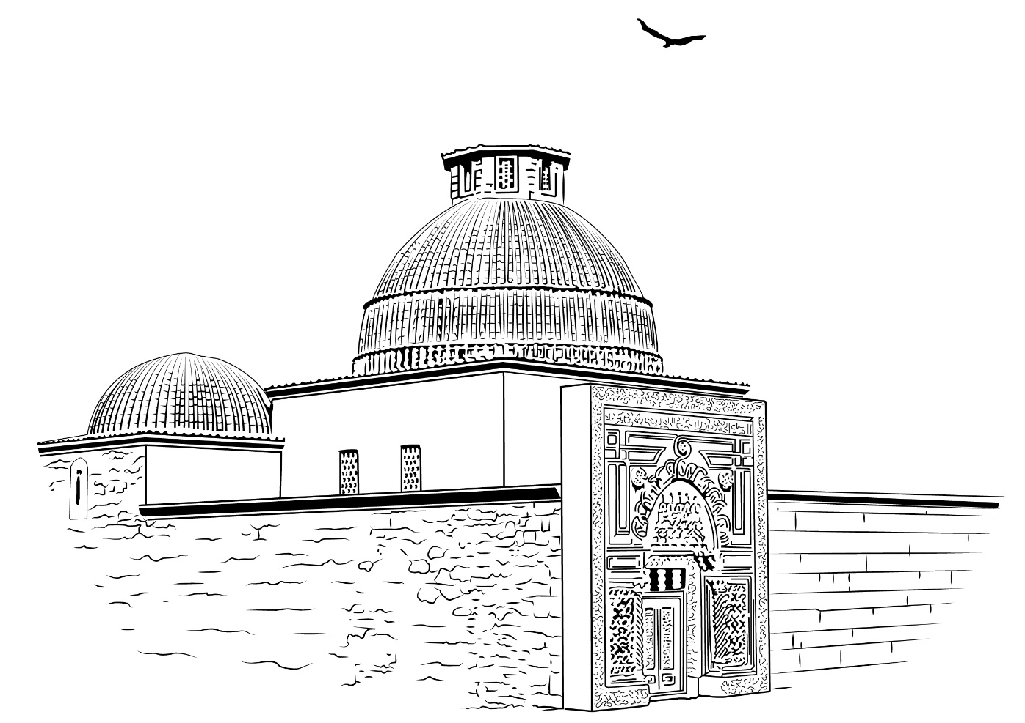
KARATAY MADRASA 1251
FROM MADRASA TO UNIVERSITY…
‘’… Noble Atabey Karatay, the son of Abdullah, had a high-rise, spacious, and fine building constructed and endowed as a waqf in the capital city of Konya.‘’
444 12 51
www.karatay.edu.tr
KaratayUniversitesi
ktokaratay

Slide 2
HISTORY
1251
Karatay Madrasa
1882
The Konya Chamber of Commerce (KTO)
2009
KTO
Karatay
University
444 12 51
www.karatay.edu.tr
KaratayUniversitesi
ktokaratay

Slide 3
KTO KARATAY UNIVERSITY BY NUMBERS
9000 students
72 programs
6 faculties
3 graduate schools
3 academies
3 vocational schools
400 Academic Staff
300 Administrative Staff
444 12 51
www.karatay.edu.tr
KaratayUniversitesi
ktokaratay

Slide 4
FACULTIES AND DEPARTMENTS / 1
Faculty of Law | Faculty of Engineering
Faculty of Medicine | Electrical and Electronics Engineering
Faculty of Business and Administrative Sciences | Computer Engineering
Business Administration | Mechatronics Engineering
International Trade and Logistic | Mechanical Engineering
Insurance and Social Security | Civil Engineering
Energy Management | Metallurgical and Materials Engineering
Islamic Economics and Finance | Industrial Engineering
Faculty of Social and Human Sciences | Faculty of Fine Arts and Design
Social Service | Interior Design
Psychology | Architecture
Sociology | Graphic Design
History | Traditional Turkish Arts
Communication Design and Management
444 12 51
www.karatay.edu.tr
KaratayUniversitesi
ktokaratay

Slide 5
FACULTIES AND DEPARTMENTS / 2
Academy of Foreign Languages | Vocational School of Healthcare Services
Translation and Interpreting (Arabic-Turkish) | Child Development
Translation and Interpreting (English-Turkish) | Dialysis
Sağlık Bilimleri Yüksekokulu | Physical Therapy
Child Development | First and Immediate Aid
Nursing | Anaesthesia
Audiology | Medical Imaging Techniques
Nutrition and Dietetics | Vocational School of Justice
Midwifery | Justice
Physical Therapy and Rehabilitation | Academy of Applied Sciences Pilot Training
444 12 51
www.karatay.edu.tr
KaratayUniversitesi
ktokaratay

Slide 6
POST GRADUATE AND DOCTORAL DEGREES
Graduate School of Sciences
Computer Forensics (MSc/Thesis) | Electrical and Computer Engineering (MSc/Non-Thesis)
Electrical and Computer Engineering (MSc/Thesis) | Architecture (MSc/Non- Thesis)
Architecture (MSc/Thesis) | Civil Engineering (MSc/Non-Thesis)
Civil Engineering (MSc/Thesis) | Architecture (PhD)
Mechatronics Engineering (MSc/Thesis) | Civil Engineering (PhD)
Graduate School of Social Sciences
Family Counselling (MA/Thesis) | Sociology (MA/Thesis)
Energy Management (MA/Thesis) | International Trade (MA/Thesis)
Graphic Design (MA/Thesis) | History (MA/Thesis)
Business Administration (MA/Thesis) | Energy Management (MA/Non-Thesis)
Human Resources and Social Service (MA/Thesis) | Accounting and Auditing (MA/Non-Thesis)
Public Law (LLM/Thesis) | Business Administration (MA/Non-Thesis)
Private Law (LLM/Thesis) | Business Administration (PhD)
Graduate School of Health Sciences
Audiology (MSc/Thesis) Child Development (MSc/Non-Thesis) | Child Development (MSc/Thesis) Mental Health and Psychiatric Nursing (MSc/Thesis)
444 12 51
www.karatay.edu.tr
KaratayUniversitesi
ktokaratay

Slide 7
Double Major Opportunities: KTO Karatay University offers tens of double major opportunities from Mechanical Engineering, Business Administration and Sociology to Child Development, Architecture and Audiology.
EDUCATION OPPORTUNITIES
Study 8 different languages: As well as English, our students can take Chinese, Japanese, French, Arabic, Persian, Russian and German language courses as their electives.
444 12 51
www.karatay.edu.tr
KaratayUniversitesi
ktokaratay

Slide 8
SECTOR CONSULTING PROJECT
Masters are meeting with apprentices!
The experienced leaders of the business and industrial world, who are also members of The Konya Chamber of Commerce are identified with the related department for each freshman.
Sector Consultants work in cooperation with the academic consultants of students.
Students turn what they learn in classrooms into practice with the help of their Sector Consultants.
444 12 51
www.karatay.edu.tr
KaratayUniversitesi
ktokaratay

Slide 9
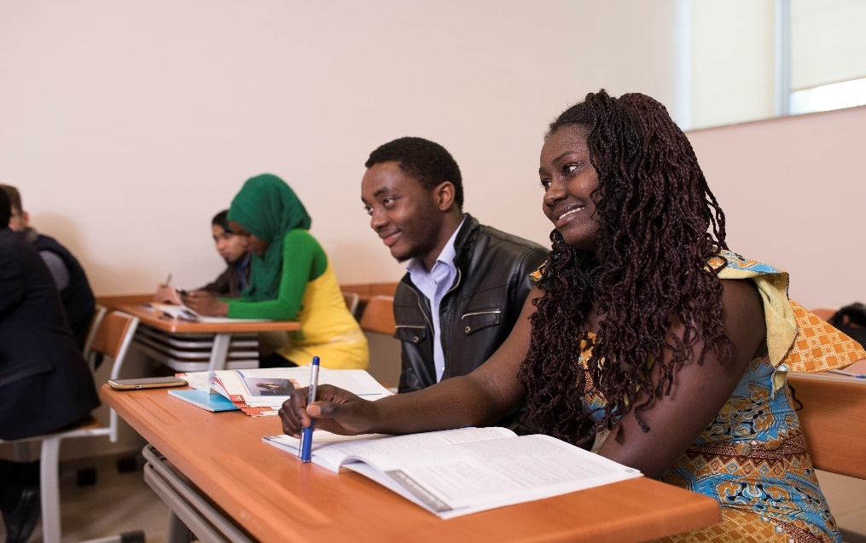
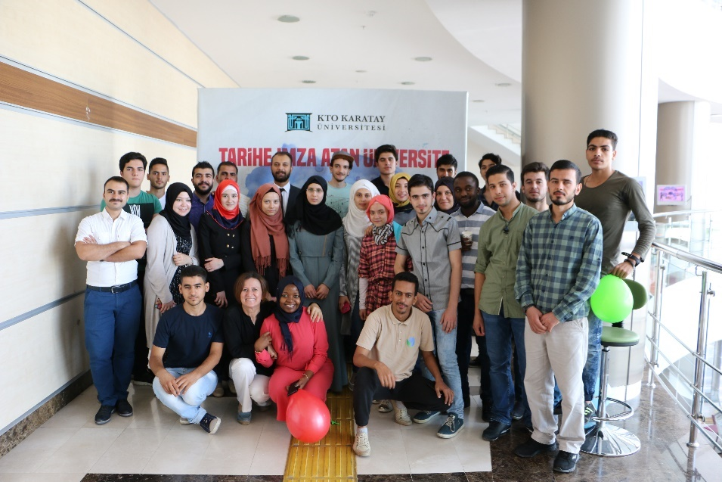
KTO KAR-DIL: TURKISH LANGUAGE TRAINING
Since 2012 KTO KAR_DIL has helped hundreds of international students from 73 countries improve their Turkish language skills to enable them enter a university in Turkey. | 4
444 12 51
www.karatay.edu.tr
KaratayUniversitesi
ktokaratay

Slide 10
UZEM: DISTANCE LEARNING CENTER
All students at KTO Karatay University have the chance to follow mass courses anywhere, anytime they want. The distance learning center provides course content, course materials and exams for the whole campus. Online Courses: History of Ataturk’s Principles and Reforms I-II Turkish Language I-II Occupational Health Safety I-II Core Information Technologies I-II | 4
444 12 51
www.karatay.edu.tr
KaratayUniversitesi
ktokaratay

Slide 11
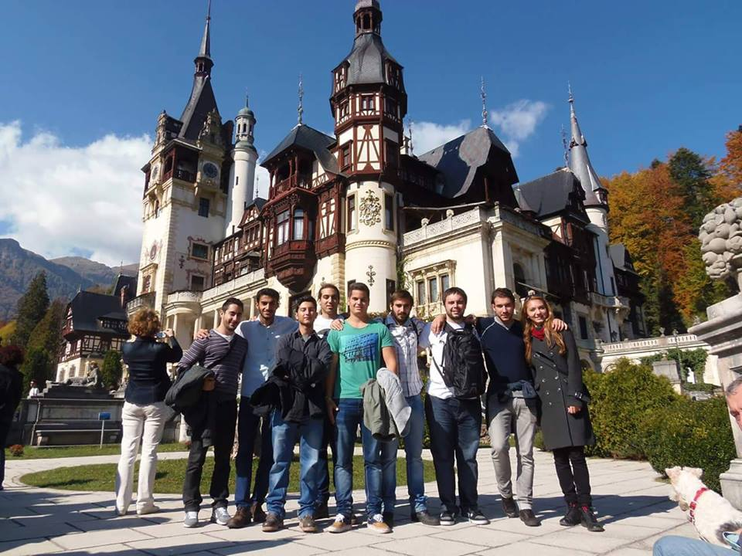
INTERNATIONAL PROGRAMS
Through our Erasmus bilateral agreements with the universities in the Germany, Portugal, Bulgaria, Romania and Poland we host international exchange students on our campus and we send our full-time students for a semester abroad.
KTO Karatay Univeristy is a also a member of International Association for the Exchange of Students for Technical Experience (IAESTE).
444 12 51
www.karatay.edu.tr
KaratayUniversitesi
ktokaratay

Slide 12
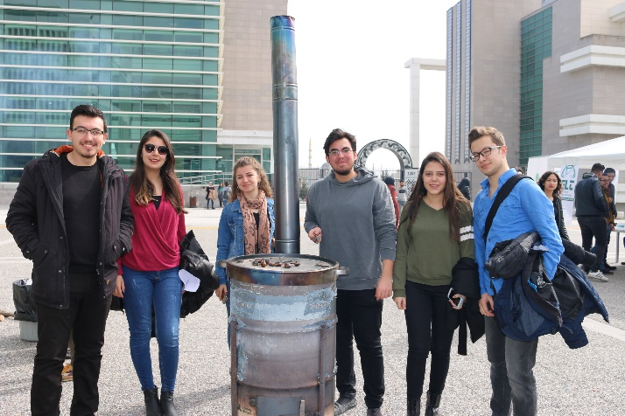
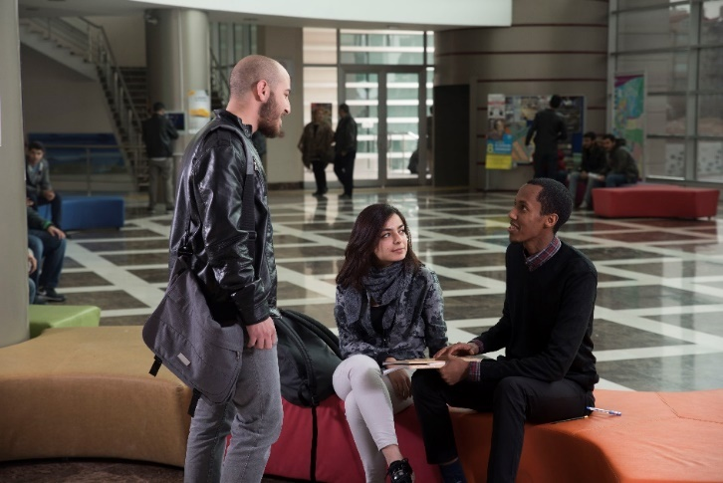
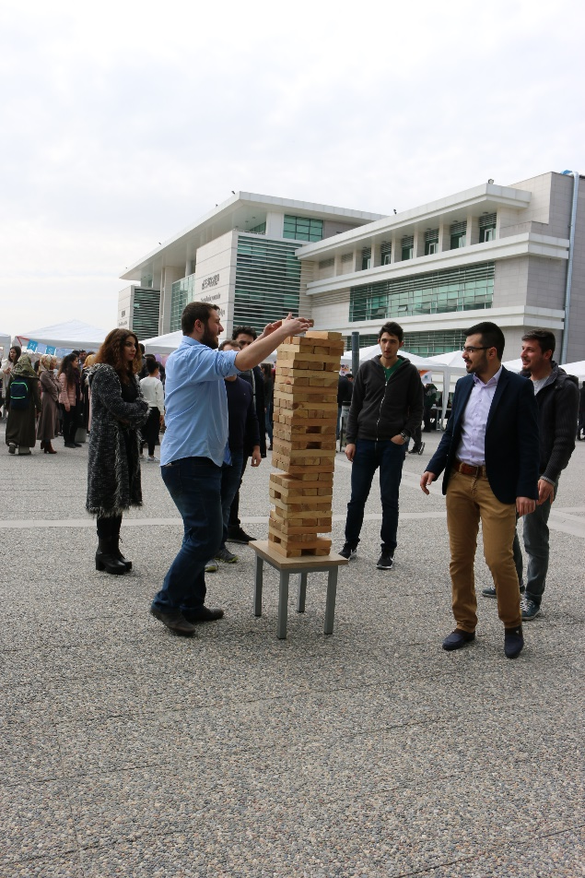
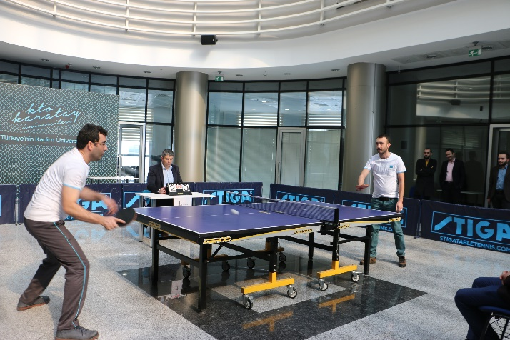
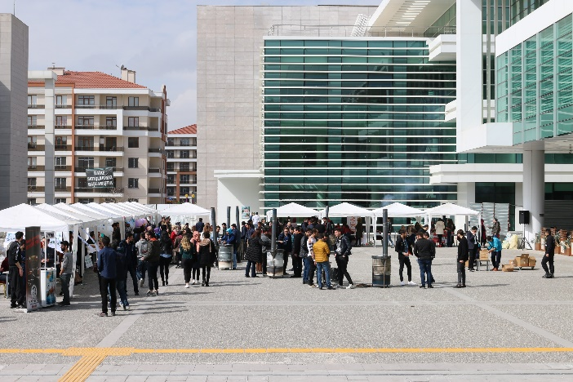
CAMPUS PHOTOS
444 12 51
www.karatay.edu.tr
KaratayUniversitesi
ktokaratay

Slide 13
PEER SUPPORT
Peer Support: It is observed that students coming from different secondary education traditions can get unsuccessful grades especially in their first year due to the problem of adaptation and not being able to focus on their courses at the university.
KTO Karatay University offers Peer Support to assist such students to keep their scholarships safe. When an international student fails an exam, he/she is matched with a student who has a good grade from that same course.
The private lessons given by the successful student are completely free.
444 12 51
www.karatay.edu.tr
KaratayUniversitesi
ktokaratay

Slide 14
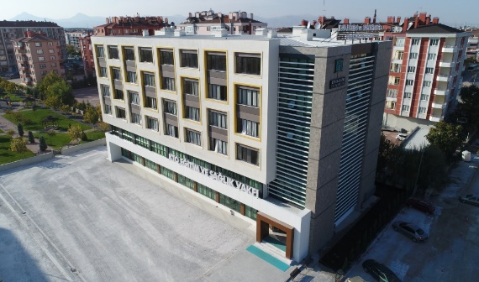
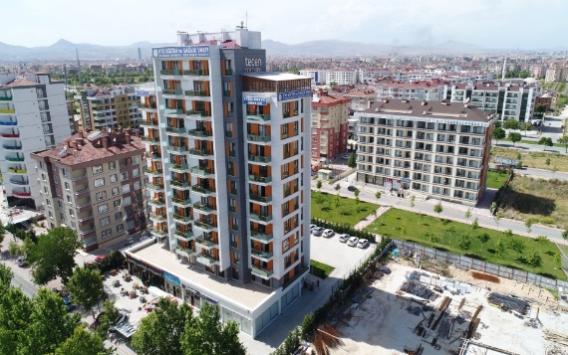
ACCOMMODATION
KTO Karatay University offers luxurious and comfortable accommodation for students coming from outside the city and abroad.
Our guesthouses located only 5 and 10 minutes' walking distance from the campus have in single, double or quadruple rooms.
444 12 51
www.karatay.edu.tr
KaratayUniversitesi
ktokaratay

Slide 15
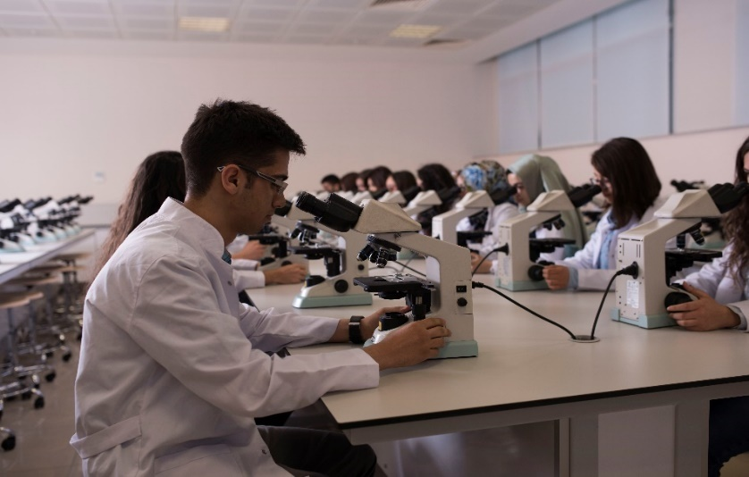
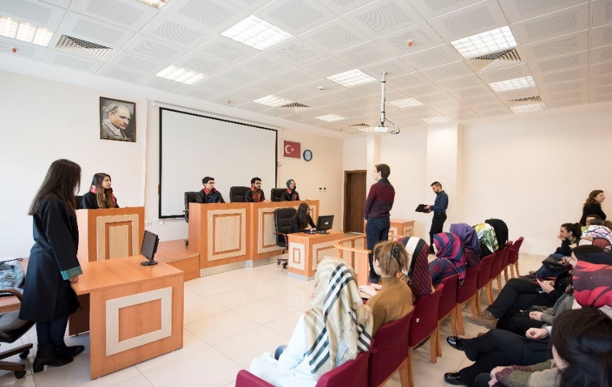
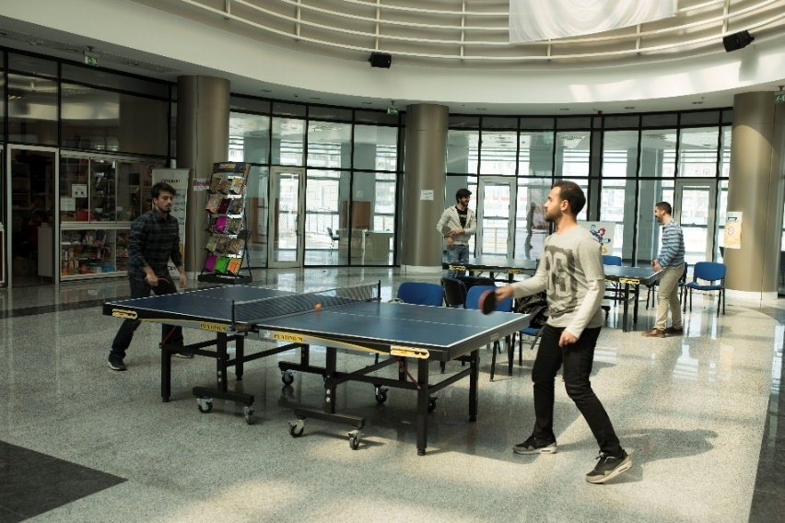
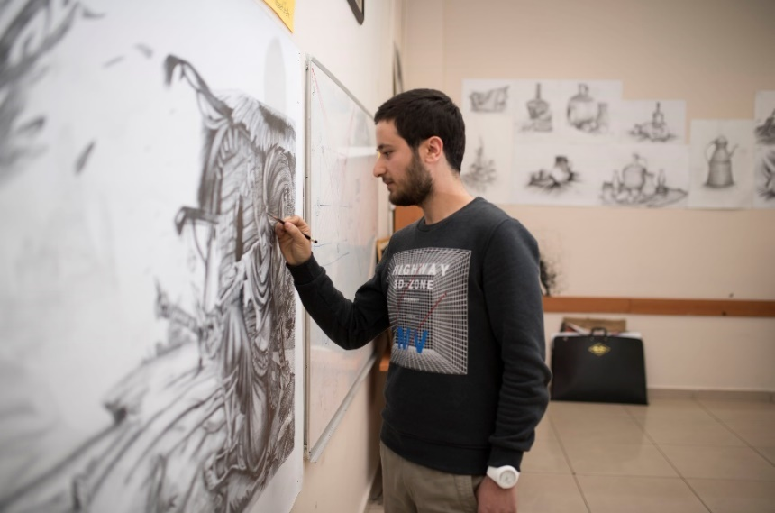
CAMPUS PHOTOS
444 12 51
www.karatay.edu.tr
KaratayUniversitesi
ktokaratay

Slide 16
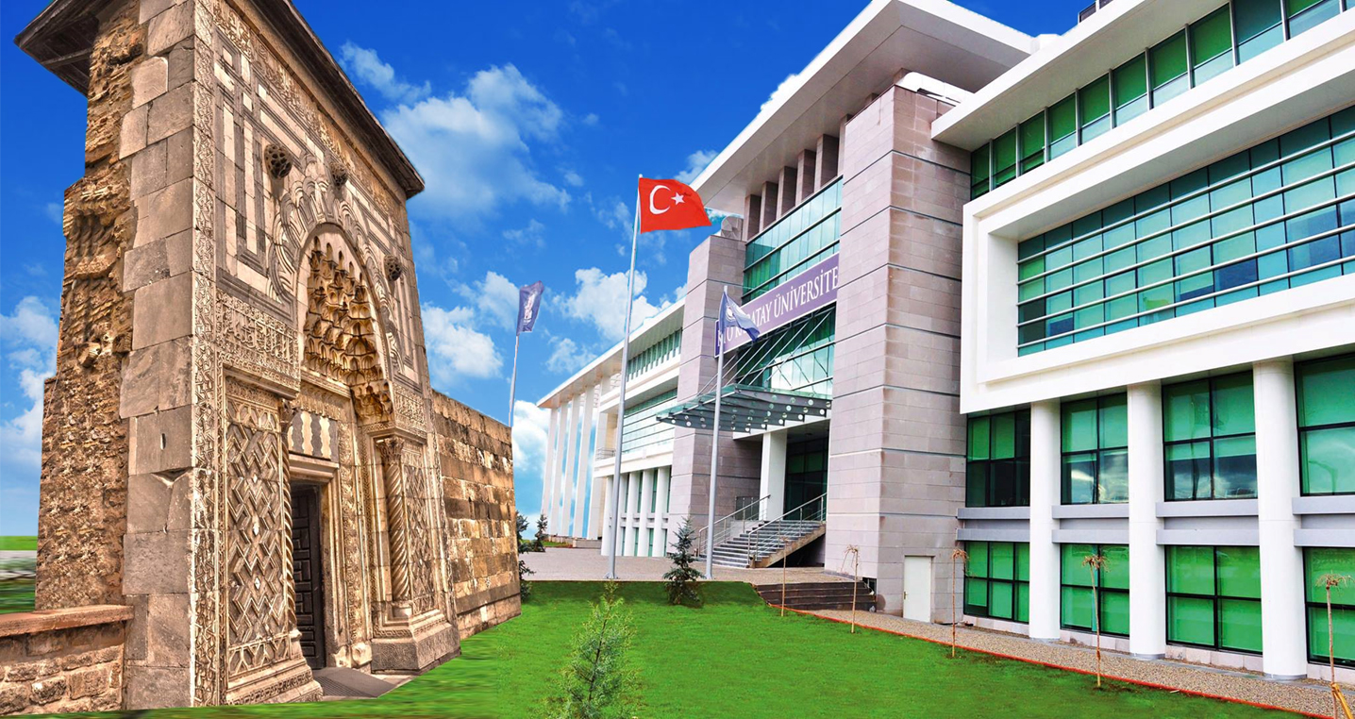
THANK YOU
444 12 51
www.karatay.edu.tr
KaratayUniversitesi
ktokaratay

